Slide 1



Sales Analysis
View in Power BI
Last data refresh:
8/24/2022 1:00:08 PM UTC
Downloaded at:
8/24/2022 1:29:52 PM UTC

Slide 2
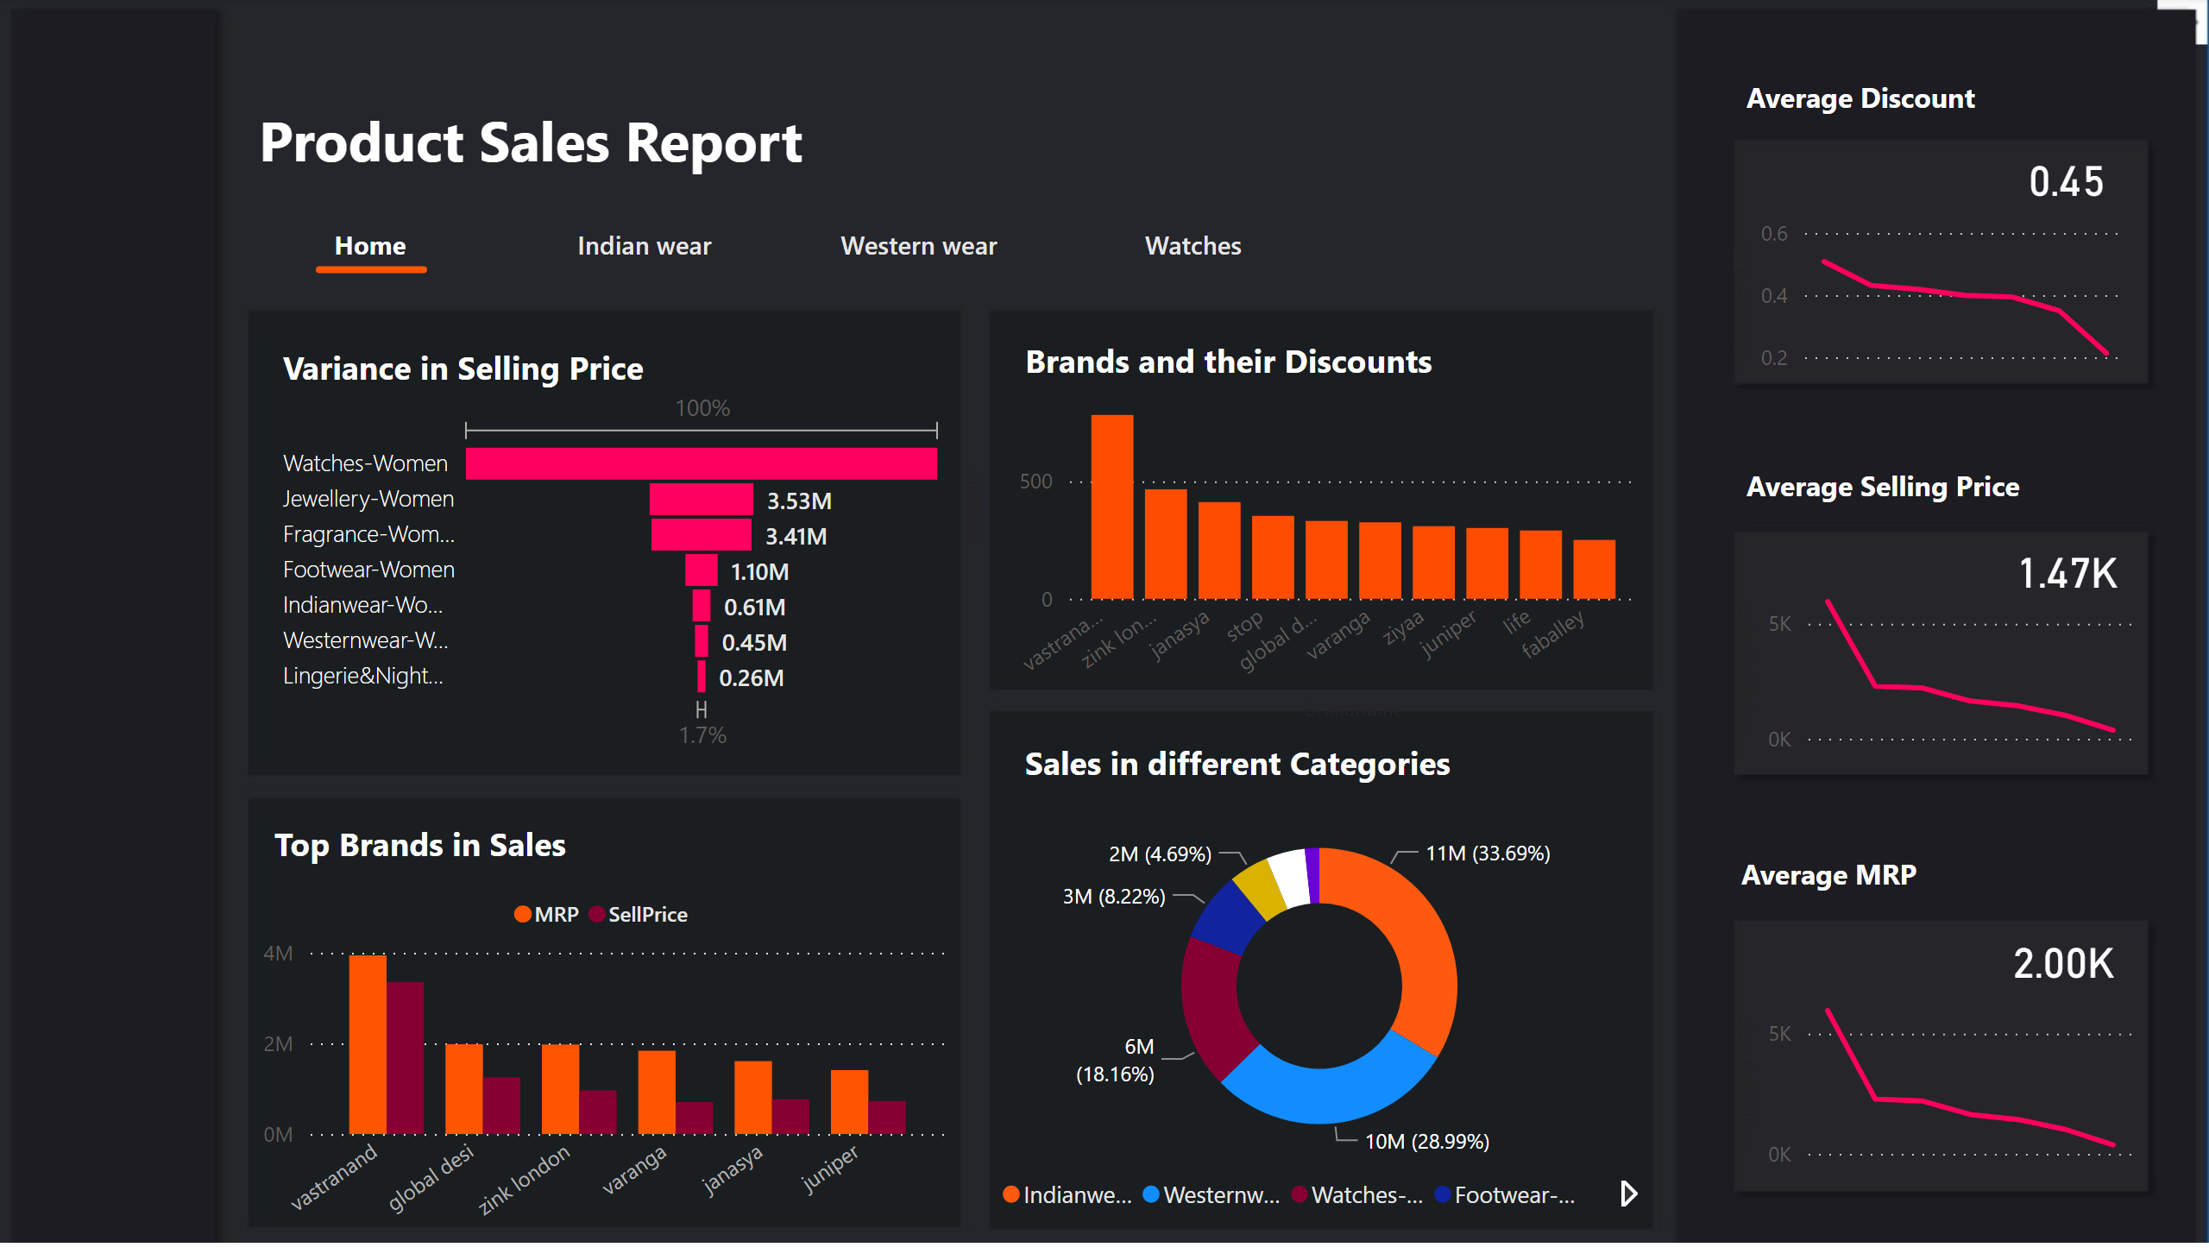
Home
Notes:
donutChart
No alt text provided
funnel
No alt text provided
clusteredColumnChart
No alt text provided
textbox
No alt text provided
lineChart
No alt text provided
card
No alt text provided
lineChart
No alt text provided
card
No alt text provided
lineChart
No alt text provided
card
No alt text provided
lineClusteredColumnComboChart
No alt text provided
pageNavigator
No alt text provided
shape
No alt text provided
textbox
No alt text provided
textbox
No alt text provided
textbox
No alt text provided
textbox
No alt text provided
textbox
No alt text provided
textbox
No alt text provided
textbox
No alt text provided

Slide 3
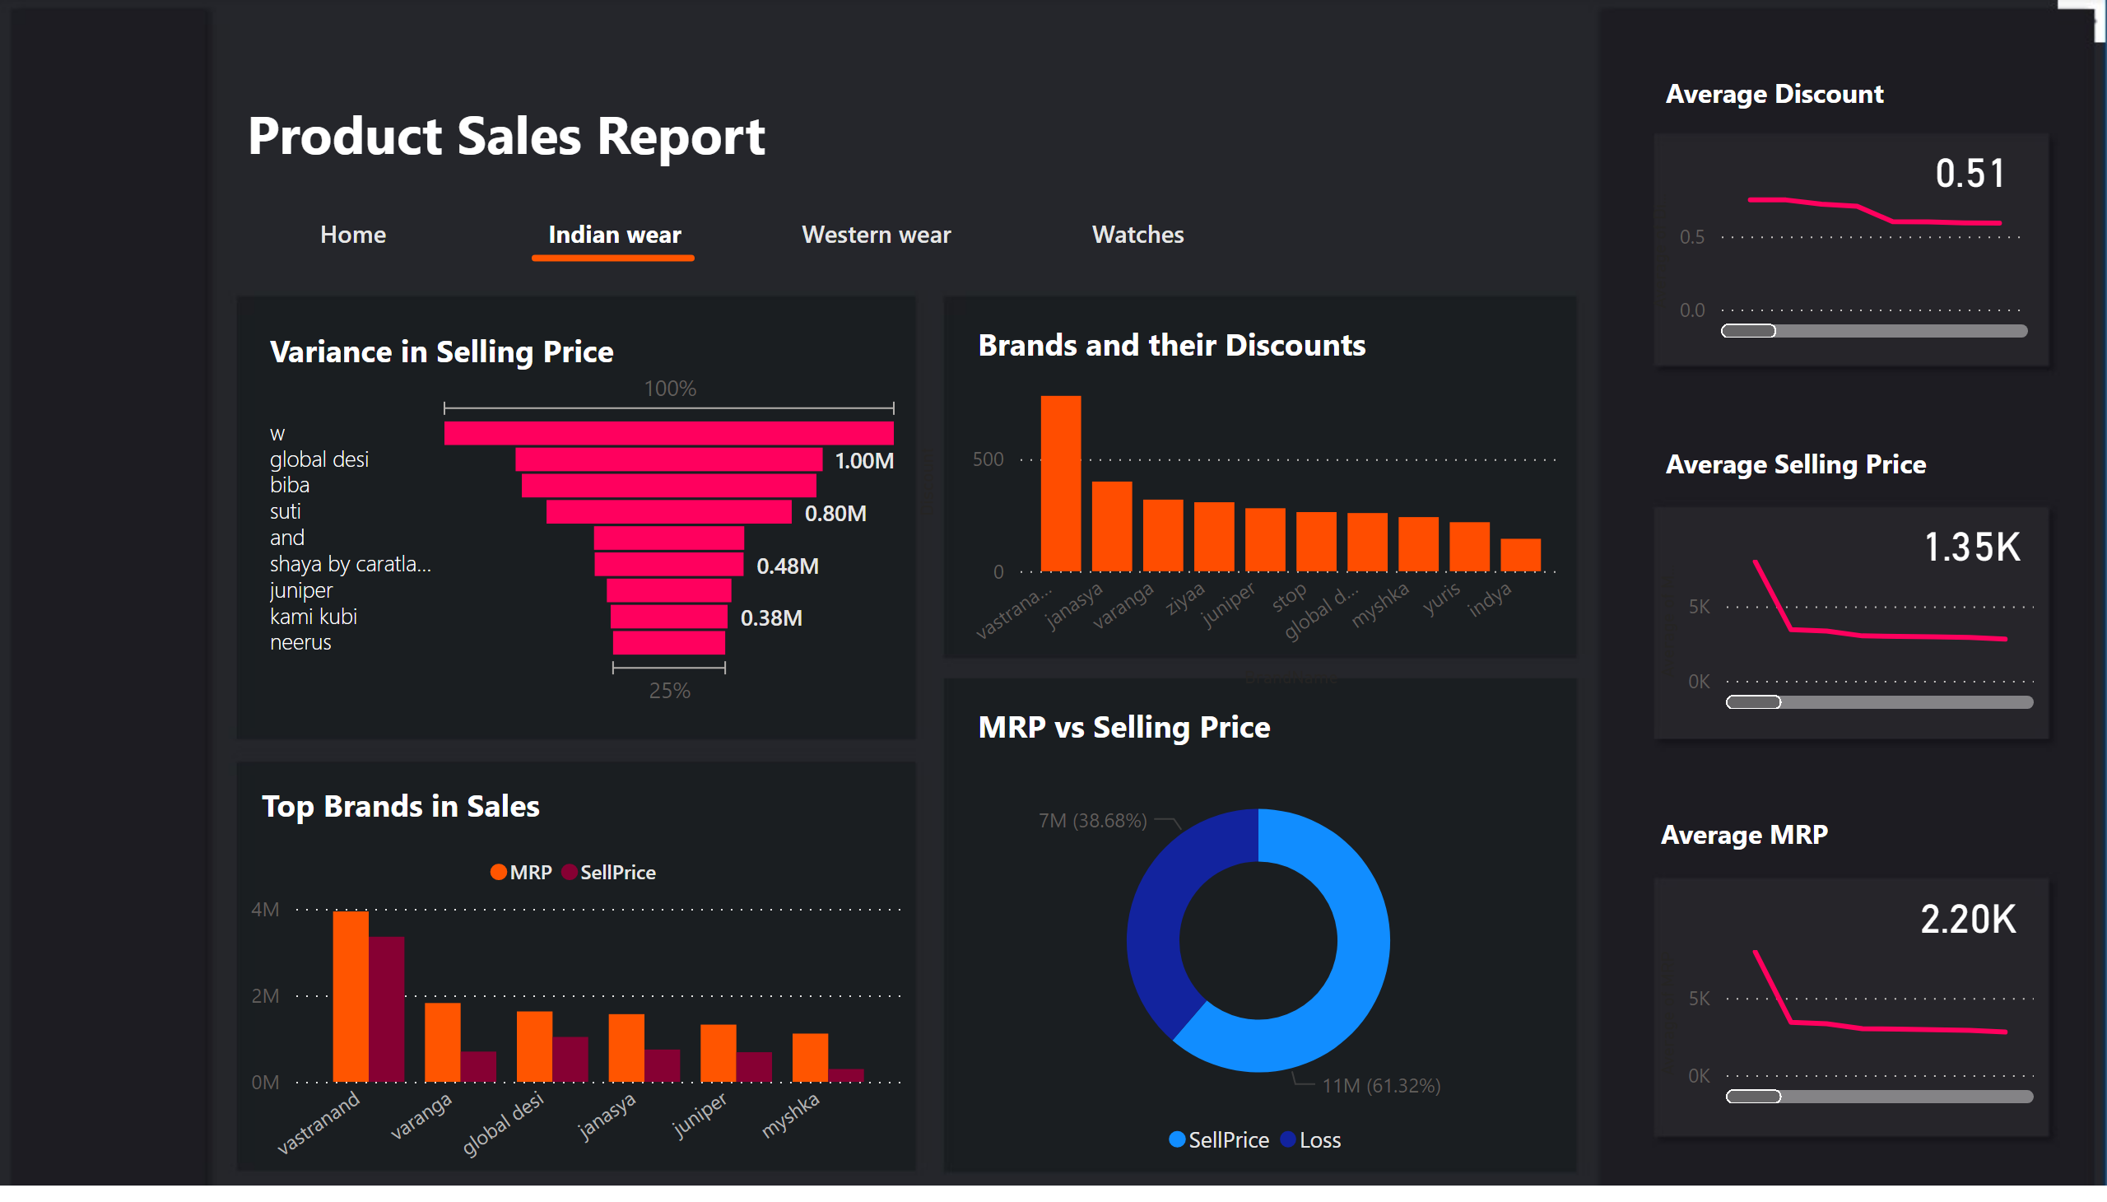
Indian wear
Notes:
donutChart
No alt text provided
funnel
No alt text provided
clusteredColumnChart
No alt text provided
textbox
No alt text provided
lineChart
No alt text provided
card
No alt text provided
lineChart
No alt text provided
card
No alt text provided
lineChart
No alt text provided
card
No alt text provided
lineClusteredColumnComboChart
No alt text provided
shape
No alt text provided
textbox
No alt text provided
textbox
No alt text provided
textbox
No alt text provided
textbox
No alt text provided
textbox
No alt text provided
textbox
No alt text provided
textbox
No alt text provided
pageNavigator
No alt text provided

Slide 4
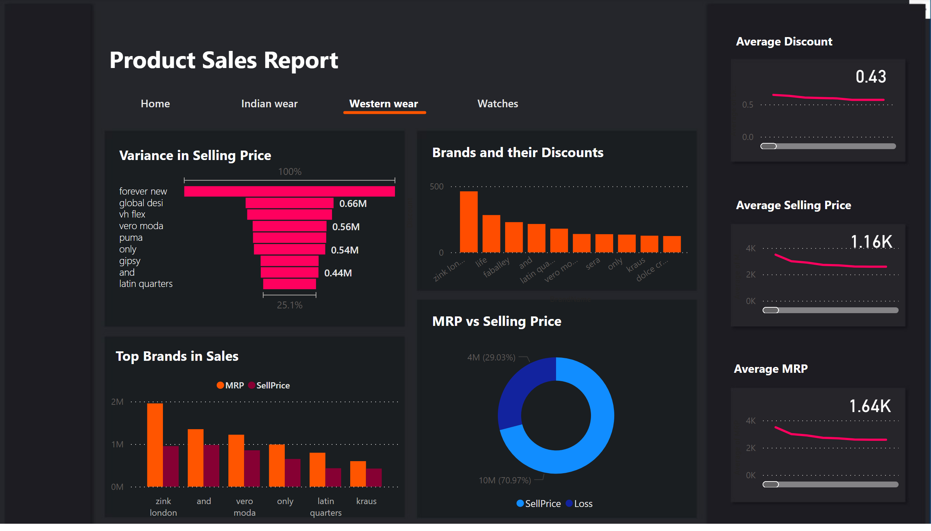
Western wear
Notes:
donutChart
No alt text provided
funnel
No alt text provided
clusteredColumnChart
No alt text provided
textbox
No alt text provided
lineChart
No alt text provided
card
No alt text provided
lineChart
No alt text provided
card
No alt text provided
lineChart
No alt text provided
card
No alt text provided
lineClusteredColumnComboChart
No alt text provided
shape
No alt text provided
textbox
No alt text provided
textbox
No alt text provided
textbox
No alt text provided
textbox
No alt text provided
textbox
No alt text provided
textbox
No alt text provided
textbox
No alt text provided
pageNavigator
No alt text provided

Slide 5
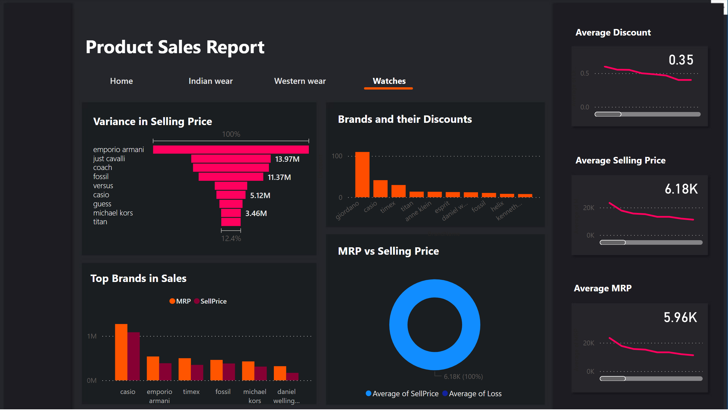
Watches
Notes:
textbox
No alt text provided
shape
No alt text provided
textbox
No alt text provided
textbox
No alt text provided
textbox
No alt text provided
textbox
No alt text provided
textbox
No alt text provided
textbox
No alt text provided
textbox
No alt text provided
pageNavigator
No alt text provided
card
No alt text provided
lineClusteredColumnComboChart
No alt text provided
clusteredColumnChart
No alt text provided
card
No alt text provided
funnel
No alt text provided
card
No alt text provided
lineChart
No alt text provided
lineChart
No alt text provided
lineChart
No alt text provided
donutChart
No alt text provided

Slide 6
Quick Insights From Data
The Watches are the most seen items in the highest price
range of 7500+ Rs. per item.
There is not a single watch in the range of 0-500.
Jewelry is available in all the price ranges
The most sold products are
western wears in the price range
of 500-1000 Rs followed by
Indian wears in the same range.
The Watches in that price range
are the least sold and most
expensive products.
The Lingerie and Nightwear in
the range of 3500-5000 Rs are
sold rarely.
western wear and Indian wear
above the price of 5000 are the
least favored products.
The maximum discount offered on the product is Rs. 15750/-
The top 5 products belong to the swiss eagle brand and coach
brand.
All the products are watches and offering discounts from 40%
to 70%
The watches of the Swiss eagle are with lower MRP and yet
offer
70% discount hence very reduced actual selling price.
The watches of coach are expensive and yet offer lesser
discount compared to the swiss eagle.

